Slide 1
Noisy Channel: Stop and Wait, Automatic Repeat Request, go-back-n, selective repeat
Lecture: 20-22
Prepared by: Dr. Gagan Singla
Department of Computer Science and Engineering,
Chitkara University, Punjab

Slide 2
Transport Layer Protocols
Noiseless Channel Protocols
Simple Protocol
Stop and Wait Protocol
Noisy Channel Protocols
Stop and Wait ARQ Protocol
Go-Back-N Protocol
Selective-Repeat Protocol
﻿Piggybacking

Slide 3
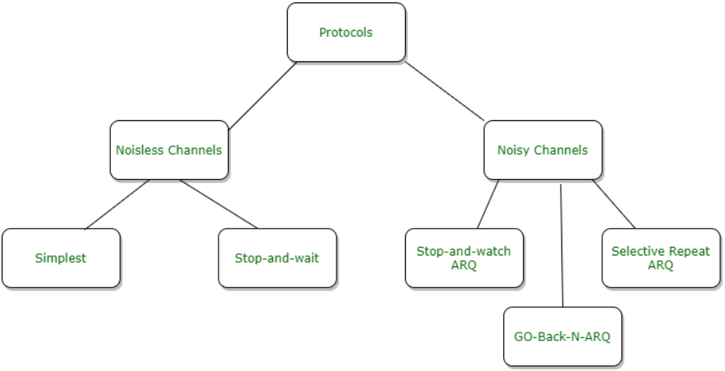
Categorization of protocols
Figure 1. Categorization of Protocols

Slide 4
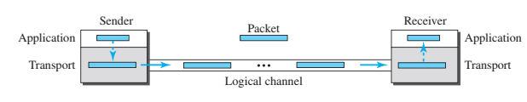
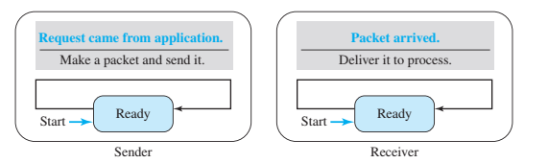
Transport Layer Protocols
Simple Protocol
Figure 2. Simple Protocol
Figure 2. FSM for Simple Protocol

Slide 5
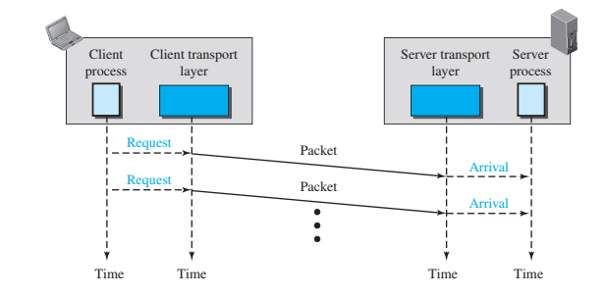
Transport Layer Protocols
1) Simple Protocol
The sender sends packets one after another without even thinking about the receiver
An idealistic channel in which no frames are lost, corrupted or duplicated.
The protocol does not implement error control in this category.
Figure 3. Simple Protocol Flow

Slide 6
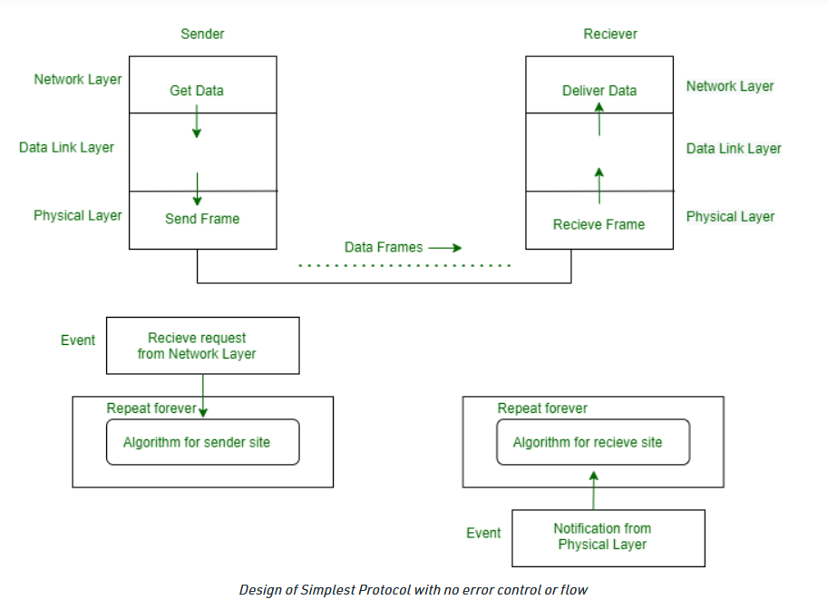
Noiseless Channel :
Simplest Protocol
Figure 4. Design of Simplest Protocol with no error control or flow

Slide 7
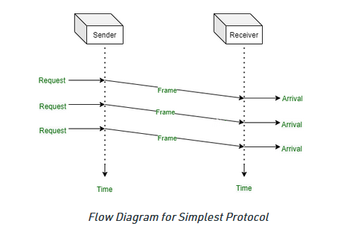
Flow Diagram :
Figure 5. Flow Diagram for Simplest Protocol

Slide 8
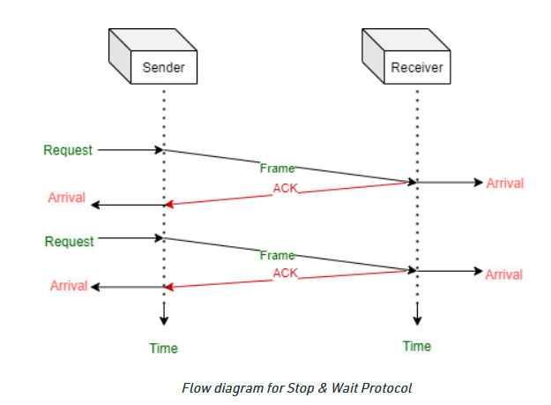
Noiseless Channel :
2) Stop and Wait Protocol
Figure 6. Flow Diagram for Stop n Wait Protocol

Slide 9
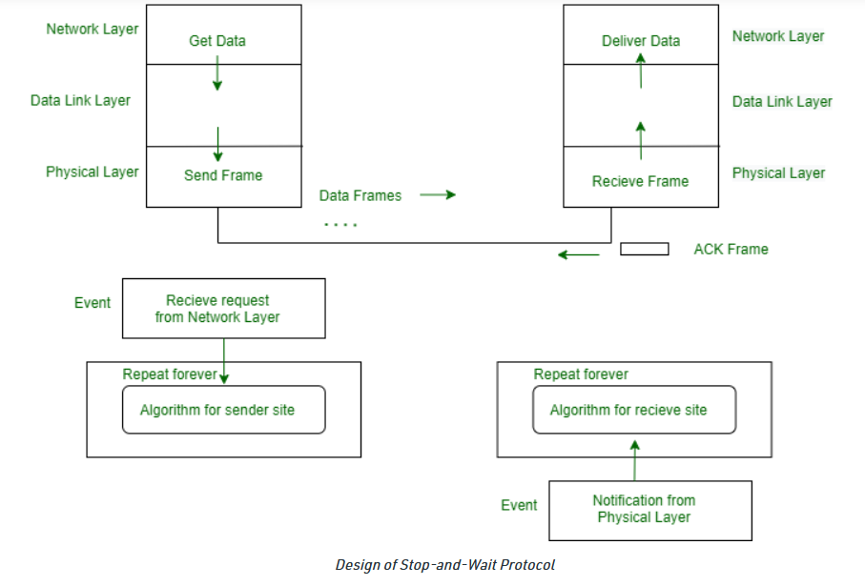
Stop and Wait Protocol
Figure 7. Design of Stop and Wait Protocol

Slide 10
Stop and Wait Protocol
Both the sender and the receiver use a sliding window of size 1.
The sender sends one packet at a time and waits infinitely for an acknowledgment before sending the next one.
If a timeout system is setup there are no sequence numbers. So, retransmission of a packet cannot be done.

Slide 11
Noisy Channel Protocols
1) Stop and Wait ARQ Protocol
Uses both flow and error control.
Both the sender and the receiver use a sliding window of size 1.
The sender sends one packet at a time and waits for an acknowledgment before sending the next one.
To detect corrupted packets, a checksum is added to each data packet.
When a packet arrives at the receiver site, it is checked.
If its checksum is incorrect, the packet is corrupted and silently discarded.
﻿The silence of the receiver is a signal for the sender that a packet was either corrupted or lost.

Slide 12
Transport Layer Protocols
1) Stop and Wait Protocol ARQ (Cont’d)
Every time the sender sends a packet, it starts a timer.
If an acknowledgment arrives before the timer expires, the timer is stopped and the sender sends the next packet (if it has one to send).
If the timer expires, the sender resends the previous packet, assuming that the packet was either lost or corrupted.
This means that the sender needs to keep a copy of the packet until its acknowledgment arrives.
Only one packet and one acknowledgment can be in the channels at any time.
﻿In the Stop-and-Wait protocol, the acknowledgment number always announces, in modulo-2 arithmetic, the sequence number of the next packet expected.

Slide 13
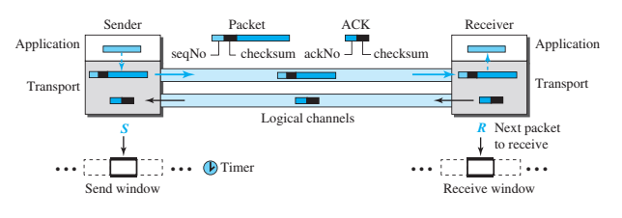
Transport Layer Protocols
1) Stop and Wait ARQ Protocol
Figure 8. Stop and Wait Protocol

Slide 14
Flow Diagram :
Figure 9. Flow Diagram for Stop and Wait Protocol

Slide 15
Transport Layer Protocols
2) Go-back-N Protocol (GBN)
﻿can send several packets before receiving acknowledgments, but the receiver can only buffer one packet.
﻿several data packets and acknowledgments can be in the channel at the same time.
﻿﻿In the Go-Back-N protocol, the acknowledgment number is cumulative and ﻿defines the sequence number of the next packet expected to arrive.

Slide 16
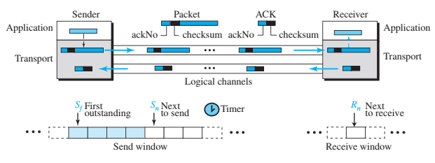
Transport Layer Protocols
2) Go-back-N Protocol (GBN)
Figure 10. Go-Back-N Protocol

Slide 17
Go-Back-N protocol
Go-Back-N protocol, also called Go-Back-N Automatic Repeat reQuest (ARQ), is a data link layer protocol that uses a sliding window method for reliable and sequential delivery of data frames.
It is a case of sliding window protocol having to send window size of N and receiving window size of 1
Concept
Introduce a window of size n
Can inject n packets into network before hearing an ACK
Sliding window
Label each packet with a sequence number
A window is a collection of adjacent sequence numbers
The size of the collection is the sender’s window size
Notes:
‹#›

Slide 18
Go-Back-N Protocol
Why called Go-Back-N
The receiver accepts packets only in sequence; it does not buffer packets received out of order.
Consequently, if the transmitter sends N packets and if the first is lost, then it must resend all the N packets starting from the first one.
Hence the name Go-Back-N.
Working Principle
Go – Back – N ARQ provides for sending multiple frames before receiving the acknowledgment for the first frame.
The finite no. of frames are sequentially numbered
The maximum number of frames that can be sent depends upon the size of the sending window.
Notes:
‹#›

Slide 19
Go-Back-N Protocol
If the acknowledgment of a frame is not received within an agreed upon time period, all frames starting from that frame are retransmitted.
The size of the sending window determines the sequence number of the outbound frames.
If the sequence number of the frames is an n-bit field, then the range of sequence numbers that can be assigned is 0 to 2^{n}−1. Consequently, the size of the sending window is 2^{n}−1.
Thus in order to accommodate a sending window size of 2^{n}−1, a n-bit sequence number is chosen
Notes:
‹#›

Slide 20
Go-Back-N Protocol
For example:
Suppose, sender has 16 frames to be transmitted which if number serially would lie from 0, 1, 2 …, 15
Consider that the header allows only 3 bits to represent the sequence number of the frame i.e. m= 3.
The sequence number would range from 0 to 2³-1 i.e. from 0 to 7.
So the 16 frames at the sender side are numbered as:
0, 1, 2, 3, 4, 5, 6, 7, 0, 1, 2, 3, 4, 5, 6, 7 and so on.
Notes:
‹#›

Slide 21
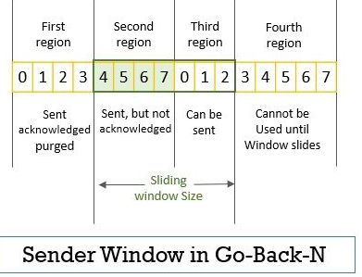
Go-Back-N Protocol
Sender Sliding Window
As in the explanation above we have m=3 the maximum size of the window would be 2² – 1= 7.
Figure 11. Sender Window in Go-Back-N Protocol
Notes:
‹#›

Slide 22
Go-Back-N Protocol
Receiver Sliding Window
In go-back-n, the size of the receiver side sliding window is 1 which limits the receiver to look for the arrival of a specific packet.
The receiver in go-back-n accepts the packets sequentially.
If it receives any packet out of order then it discards those packets which are later retransmitted by the sender.
Notes:
‹#›

Slide 23
Go-Back-N Protocol
The receiver window can be categorized into three regions:
The first region to the left has the sequence number of the frames that are received and even acknowledged.
The second region has a sequence number of only one frame that the receiver is expecting to arrive.
The third region has a sequence of frames that cannot be accepted.
Notes:
‹#›

Slide 24
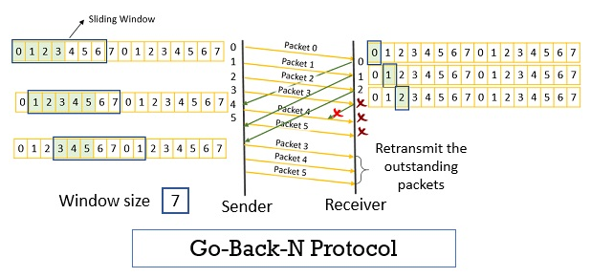
Go-Back-N Protocol
Now let us understand the working of go-back-n step by step with the help of the figure below.
Figure 12. Go-Back-N Protocol Example
Notes:
‹#›

Slide 25
Go-Back-N Protocol
Advantages:
The efficiency of this protocol is more.
The waiting time is pretty much low in this protocol.
With the help of this protocol, the timer can be set for many frames.
Also, the sender can send many frames at a time
It is a more efficient use of a connection than Stop-and-wait ARQ
Notes:
‹#›

Slide 26
Go-Back-N Protocol
Disadvantages:
Buffer requirements
Transmitter needs to store last N packets
Scheme is inefficient when delay is large and data transmission rate is high
Unnecessary retransmission of many error free packets
Notes:
‹#›

Slide 27
Go-Back-N Protocol
Sender has to buffer all unacknowledged packets, because they may require retransmission.
Receiver may be able to accept out-of-order packets, but only up to its buffer limits.
The sender needs to set timers in order to know when to retransmit a packet that may have been lost
NOTE:
STOP & WAIT: It is a special case of Go-Back-N ARQ where size of send windows is 1.
In Go-Back-N ARQ, if size of sending window is one, then it is STOP & WAIT ARQ.

Slide 28
Selective Repeat Protocol
Selective Repeat Protocol:
Selective repeat protocol, also called Selective Repeat ARQ (Automatic Repeat reQuest), is a data link layer protocol that uses sliding window method for reliable delivery of data frames.
Only the erroneous or lost frames are retransmitted, while the good frames are received and buffered.
It uses two windows of equal size: a sending window that stores the frames to be sent and a receiving window that stores the frames receive by the receiver.
The size is half the maximum sequence number of the frame. For example, if the sequence number is from 0 – 15, the window size will be 8.
﻿﻿resends only selective packets, those that are actually lost.
﻿An acknowledgment number defines the sequence number of the error-free packet received

Slide 29
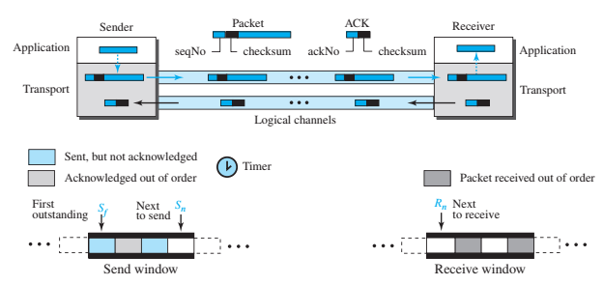
Transport Layer Protocols
2) Selective-Repeat Protocol
Figure 13. Selective- Repeat Protocol

Slide 30
Selective Repeat Protocol
Go-Back-N ARQ inefficient because multiple frames are resent when errors or losses occur
Selective Repeat retransmits only an individual frame
Timeout causes individual corresponding frame to be resent
NAK causes retransmission of oldest un-acked frame
Receiver maintains a receive window of sequence numbers that can be accepted
Error-free, but out-of-sequence frames with sequence numbers within the receive window are buffered
Arrival of frame with R_{next} causes window to slide forward by 1 or more

Slide 31
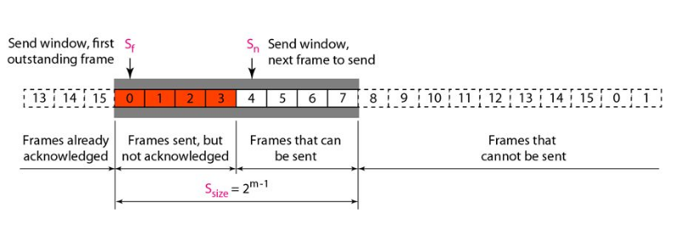
Selective Repeat Protocol
Figure 14. Sender Window for Selective Repeat ARQ Protocol

Slide 32
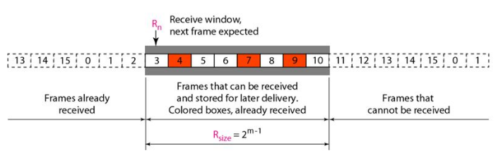
Selective Repeat Protocol
Figure 15. Receiver Window in Selective Repeat ARQ Protocol

Slide 33
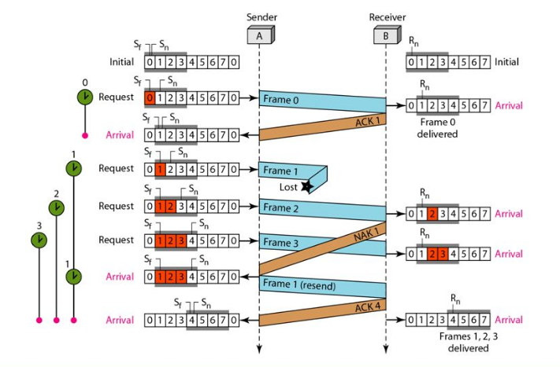
Selective Repeat Protocol
Figure 16. Flow Diagram for Selective Repeat ARQ

Slide 34
Selective Repeat Protocol
Selective Repeat Protocol example
Frame 1 is lost.
Each frame sent or resent needs a timer, which means that the timers need to be numbered (0, 1, 2, and 3).
The timer for frame 0 starts at the first request, but stops when the ACK for this frame arrives.
The timer for frame 1 starts at the second request, restarts when a NAK arrives, and finally stops when the last ACK arrives.
The other two timers start when the corresponding frames are sent and stop at the last arrival event.
At the second arrival, frame 2 arrives and is stored and marked, but it cannot be delivered because frame 1 is missing.
At the next arrival, frame 3 arrives and is marked and stored, but still none of the frames can be delivered.

Slide 35
Selective Repeat Protocol
Selective Repeat Protocol example contd...
The next point is about the ACKs.
Notice that only two ACKs are sent here.
The first one acknowledges only the first frame; the second one acknowledges three frames.
In Selective Repeat, ACKs are sent when data are delivered to the network layer.
If the data belonging to n frames are delivered in one shot, only one ACK is sent for all of them.
Notes:
‹#›

Slide 36
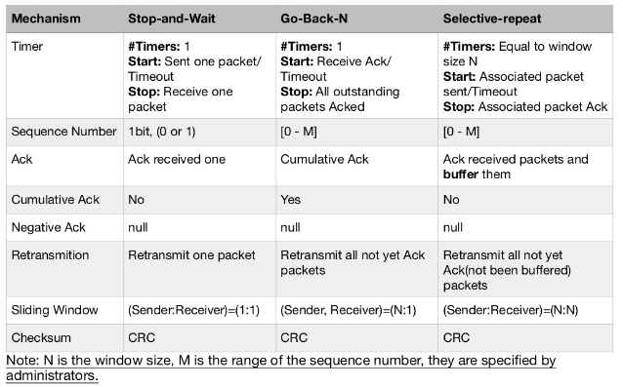
Selective Repeat Protocol
Table 1: Reliable data transfer mechanism

Slide 37
Selective Repeat Protocol
CRC:
A CRC which is short for a Cyclic Redundancy Code is a powerful type of a checksum.
A checksum is any sort of a mathematical operation that you can perform on data to make sure that the bits don't get flipped accidentally when it's stored in a memory or when it's transmitted over to a network.
So, CRCs are widely used.

Slide 38
Difference between Go-Back-N and Selective Repeat Protocol
Table 2: Difference between Go-Back-N and Selective Repeat
S.No. | Go-Back-N Protocol | Selective Repeat Protocol
1 | In Go-Back-N Protocol, if the sent frame are find suspected then all the frames are re-transmitted from the lost packet to the last packet transmitted | In selective Repeat protocol, only those frames are re-transmitted which are found suspected.
2 | Sender window size of Go-Back-N Protocol is N. | Sender window size of selective Repeat protocol is also N.
3 | Receiver window size of Go-Back-N Protocol is 1. | Receiver window size of selective Repeat protocol is N.
4 | Go-Back-N Protocol is less complex. | Selective Repeat protocol is more complex.

Slide 39
Difference between Go-Back-N and Selective Repeat Protocol
S.No. | Go-Back-N Protocol | Selective Repeat Protocol
5 | In Go-Back-N Protocol, neither sender nor at receiver need sorting. | In selective Repeat protocol, receiver side needs sorting to sort the frames.
6 | In Go-Back-N Protocol, type of Acknowledgement is cumulative. | In selective Repeat protocol, type of Acknowledgement is individual.
7 | In Go-Back-N Protocol, Out-of-Order packets are NOT Accepted (discarded) and the entire window is re-transmitted. | In selective Repeat protocol, Out-of-Order packets are Accepted.
8 | If error rate is very high, it waste lots of bandwidth | Less waste of bandwidth

Slide 40
Difference between Go-Back-N and Selective Repeat Protocol
S.No. | Go-Back-N Protocol | Selective Repeat Protocol
8 | In Go-Back-N Protocol, if Receiver receives a corrupt packet, then also, the entire window is re-transmitted. | In selective Repeat protocol, if Receiver receives a corrupt packet, it immediately sends a negative acknowledgement and hence only the selective packet is retransmitted.
9 | Efficiency of Go-Back-N Protocol is N/(1+2*a) where a is ratio of propagation delay vs transmission delay and N is number of packets sent | Efficiency of selective Repeat protocol is also N/(1+2*a)

Slide 41
Transport Layer Protocols
Piggybacking
﻿The four protocols discussed earlier in this section are all unidirectional: data packets flow in only one direction and acknowledgments travel in the other direction.
In real life, data packets are normally flowing in both directions: from client to server and from server to client.
This means that acknowledgments also need to flow in both directions.
A technique, piggybacking, is used to improve the efficiency of the bidirectional protocols.
When a packet is carrying data from A to B, it can also carry acknowledgment feedback about arrived packets from B; when a packet is carrying data from B to A, it can also carry acknowledgment feedback about the arrived packets from A.

Slide 42
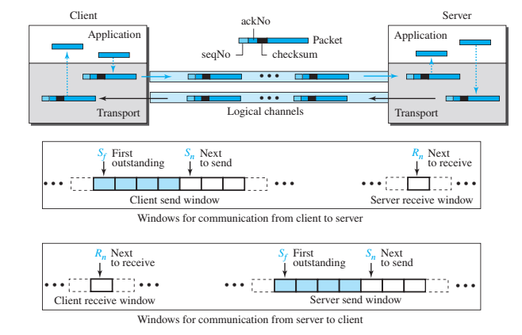
Transport Layer Protocols
Piggybacking
﻿The client and server each use two independent windows: send and receive.
Figure 17. Bidirectional Protocols

Slide 43
Piggy Backing
Piggy backing is a technique for Flow control.
The receiver waits until its network layer passes in the next data packet. The delayed acknowledgement is then attached to this outgoing data frame. This technique of temporarily delaying the acknowledgement so that it can be hooked with next outgoing data frame is known as piggybacking.
Piggybacking is a technique used for efficient utilization of bandwidth. The acknowledgment for previous segment is sent along with the data request/transfer of current segment.

Slide 44
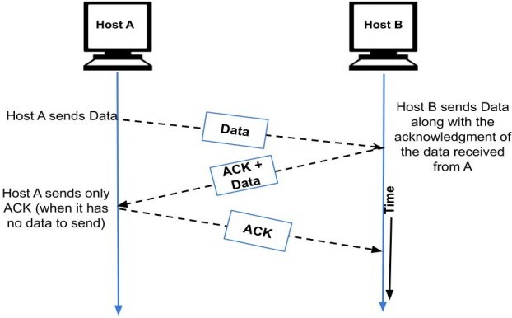
Piggy Backing
Figure 18. Piggybacking

Slide 45
Practice Questions
Question1.
Assume using stop and wait protocol, we wish to send 10 packets from source to destination and every 4th packet is lost. How many packets needs to be sent?
Solution:
Order in which packets are sent –
1 2 3 4 4 5 6 7 7 8 9 10 10
Total no of packets transmitted = 13
Packet nos retransmitted = 4, 7, 10

Slide 46
Practice Questions
Question1.
Assume a channel having error probability.
Error probability = 20%
Total no of packets sent on list = 400
What is the total no of packets to be transmitted to send all 400 packets?
Solution:
Total no. of packets to be transmitted = 400 + 400*0.2 +80*0.2 …….
= 500
20% packets will be retransmitted

Slide 47
Practice Questions
1. In the _________Protocol, if no acknowledgment for a frame has arrived, we resend all outstanding frames.
a. Stop-and-Wait ARQ
b. Go-Back-N ARQ
c. Selective-Repeat ARQ
d. none of the above
2. In the _________ protocol we avoid unnecessary transmission by sending only frames that are corrupted.
a. Stop-and-Wait ARQ
b. Go-Back-N ARQ
c. Selective-Repeat ARQ
d. none of the above

Slide 48
Practice Questions
3. Both Go-Back-N and Selective-Repeat Protocols use a _________.
a. Sliding frame
b. Sliding window
c. Sliding packet
d. none of the above

Slide 49


